Slide 1

IBM HR ANALYSIS

Slide 2
INTRODUCTION
Dataset – taken from Kaggle
Dataset Structure: 1470 observations (rows), 35 features (variables)
Missing Data: Luckily for us, there is no missing data! this will make it easier to work with the dataset.
Data Type: We only have two datatypes in this dataset: factors and integers
Label" Attrition is the label in our dataset and we would like to find out why employees are leaving the organization!
Imbalanced dataset: 1237 (84% of cases) employees did not leave the organization while 237 (16% of cases) did leave the organization making our dataset to be considered imbalanced since more people stay in the organization than they actually leave.
Columns: Age, Attrition, BusinessTravel , DailyRate, Department, DistanceFromHome, Education, EducationField, EmployeeCount, EmployeeNumber, EnvironmentSatisfaction, Gender, HourlyRate, JobInvolvement, JobLevel, JobRole, JobSatisfaction, MaritalStatus, MonthlyIncome, MonthlyRate, NumCompaniesWorked, Over18, OverTime, PercentSalaryHike

Slide 3
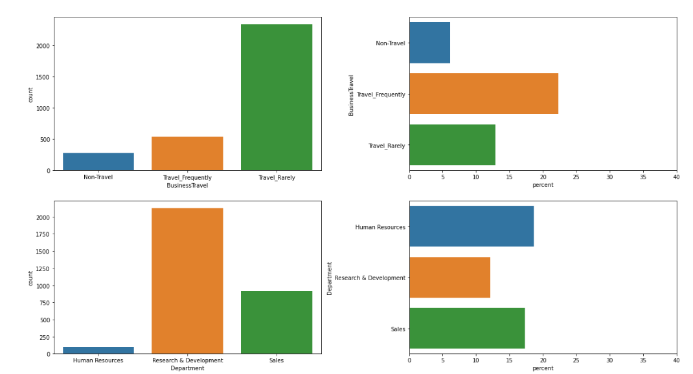

Slide 4
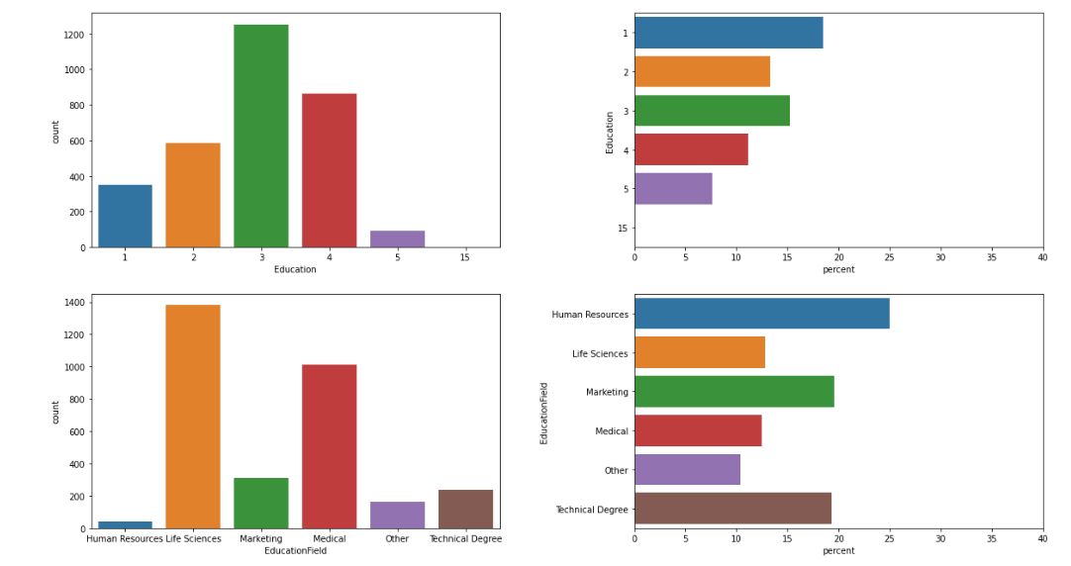

Slide 5
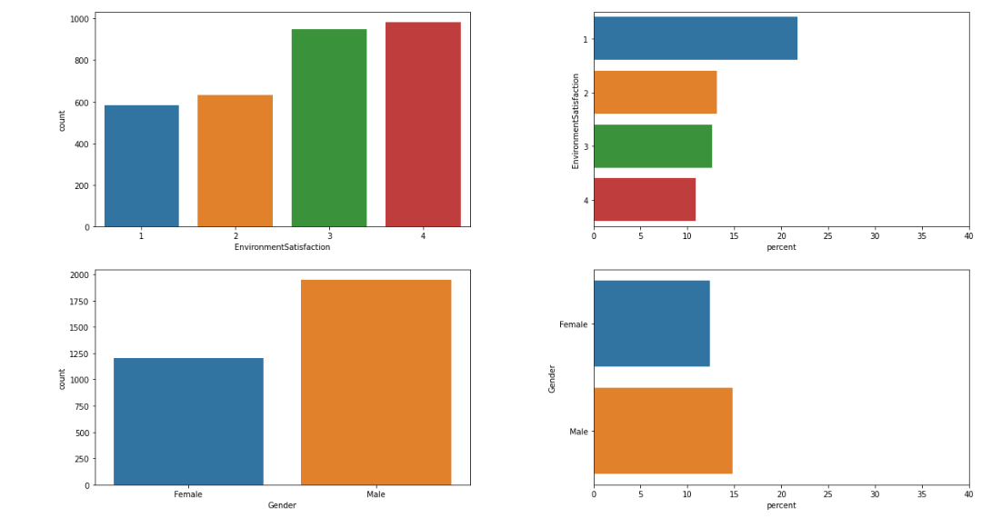

Slide 6
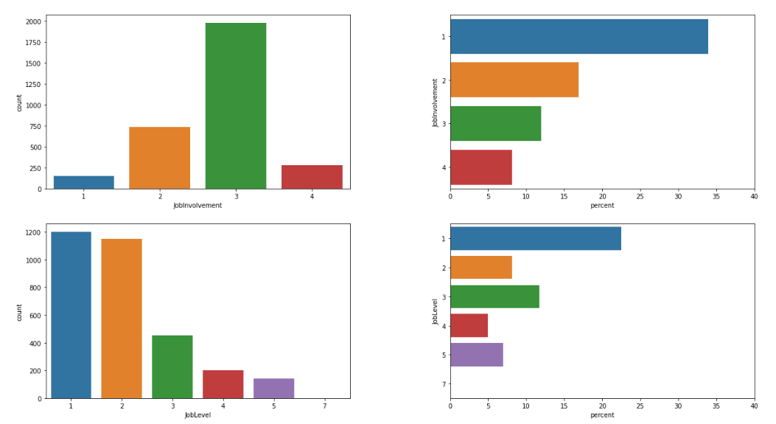

Slide 7
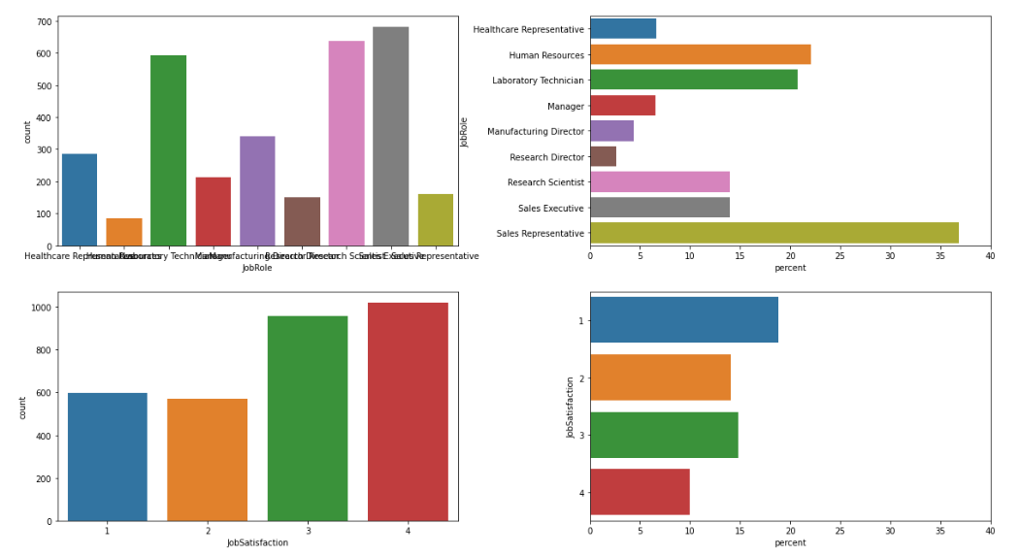

Slide 8
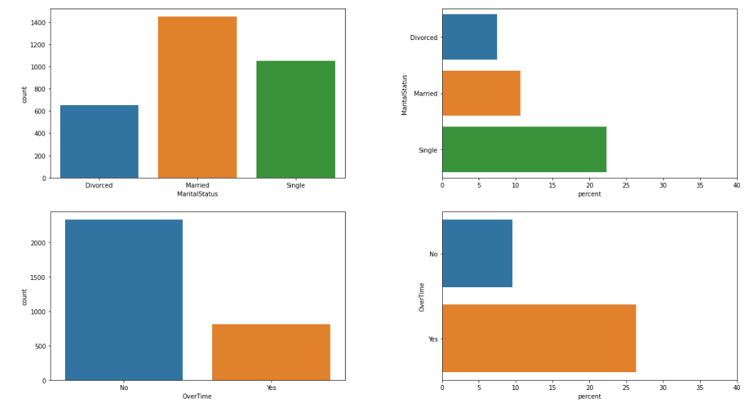

Slide 9
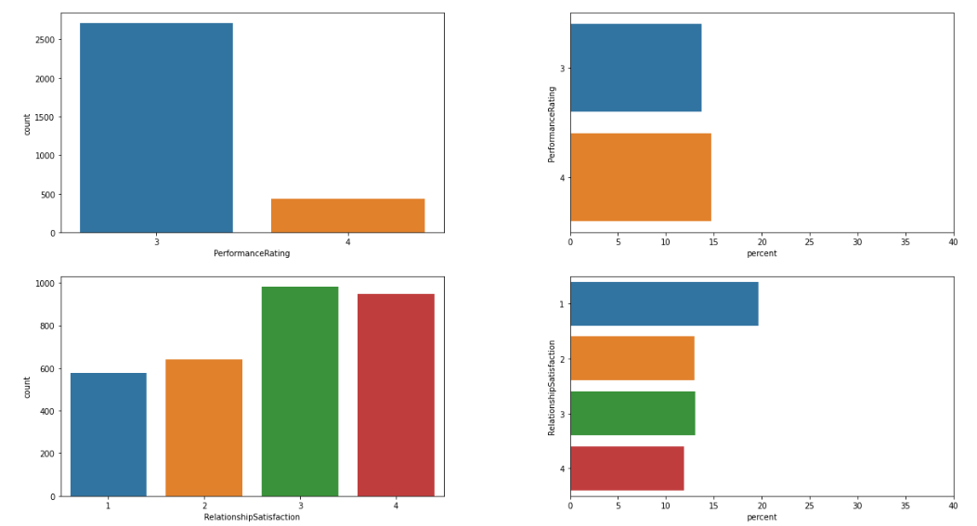

Slide 10
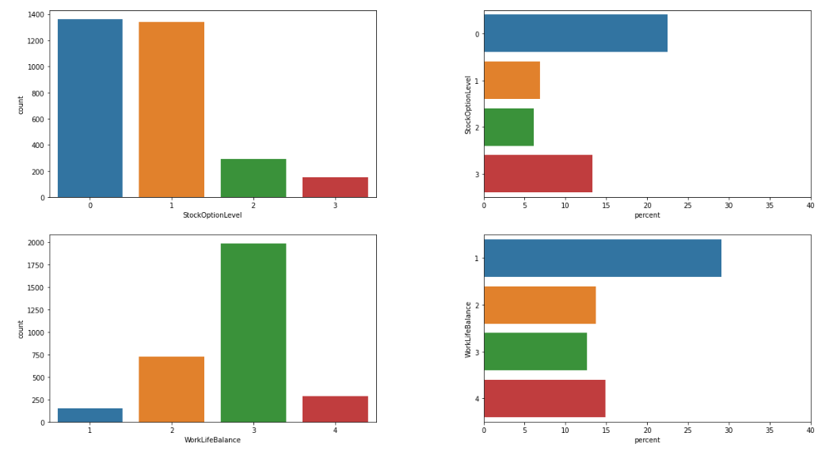

Slide 11
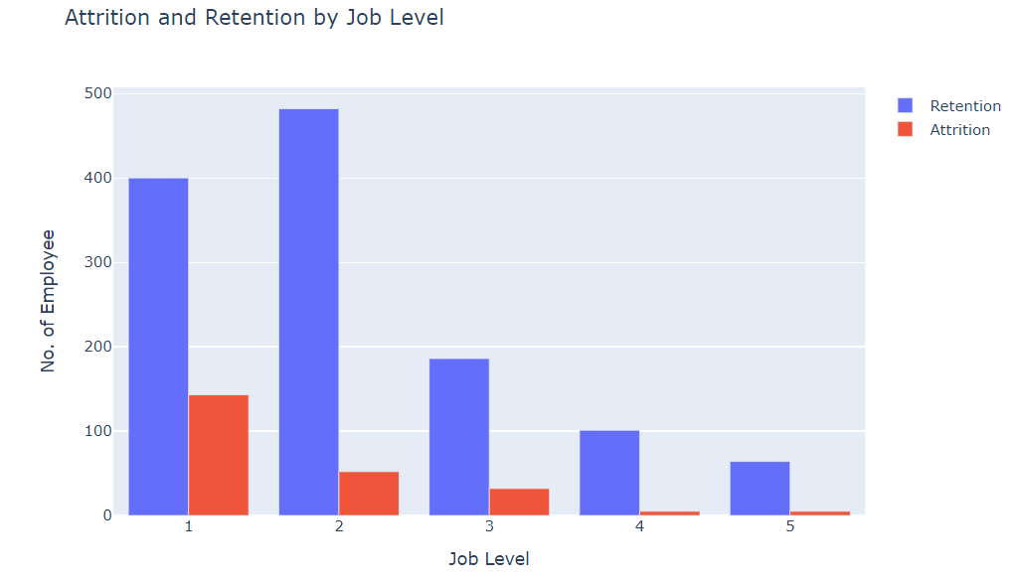
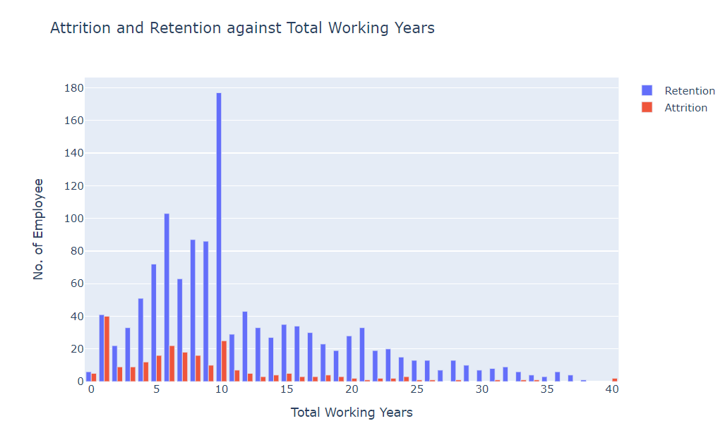
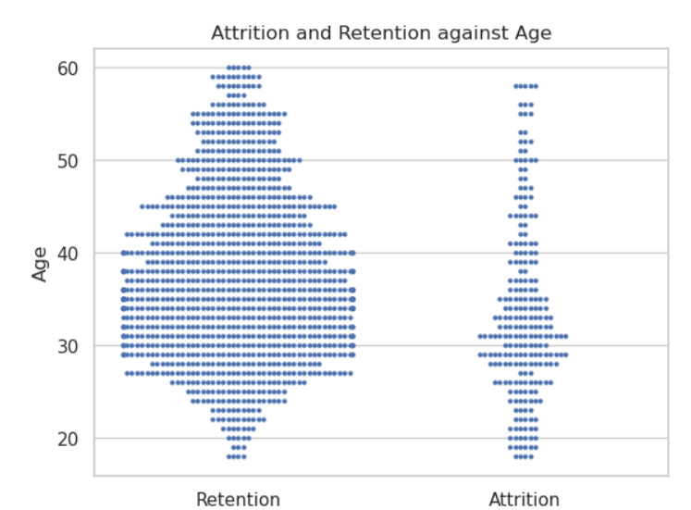
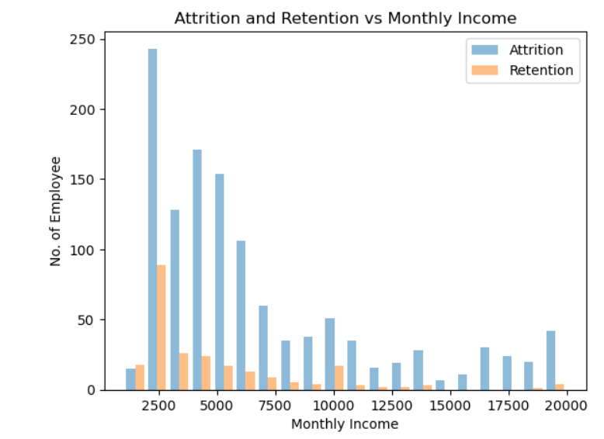

Slide 12
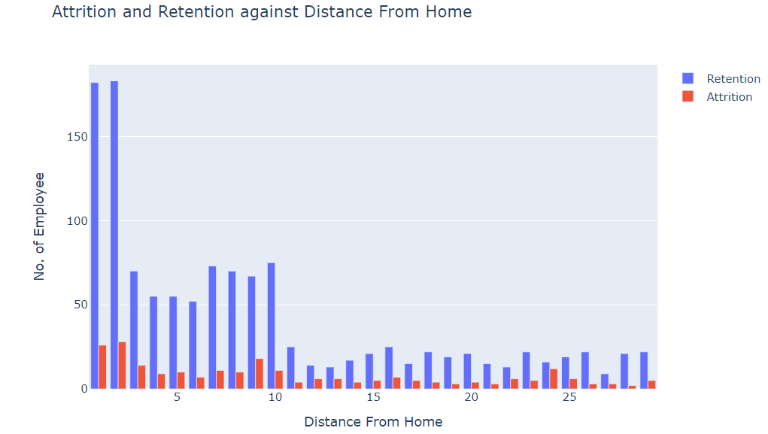
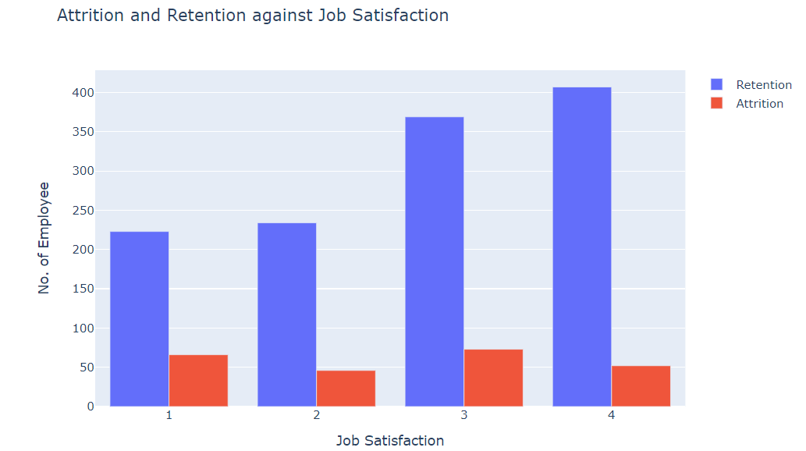
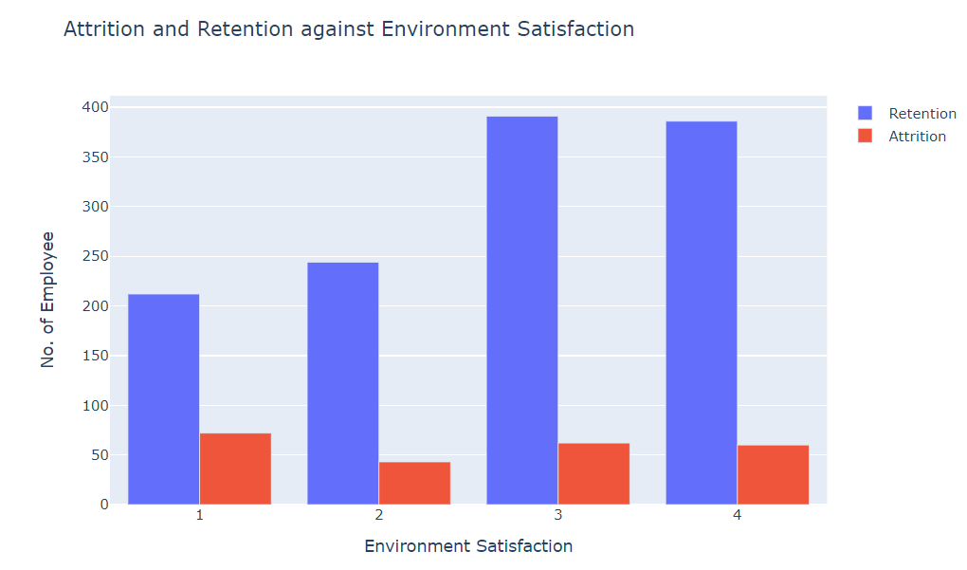
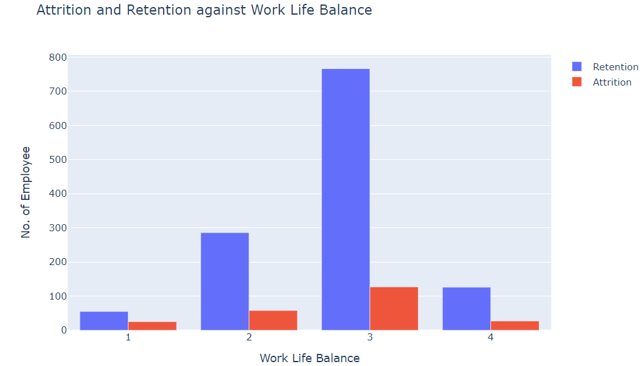

Slide 13
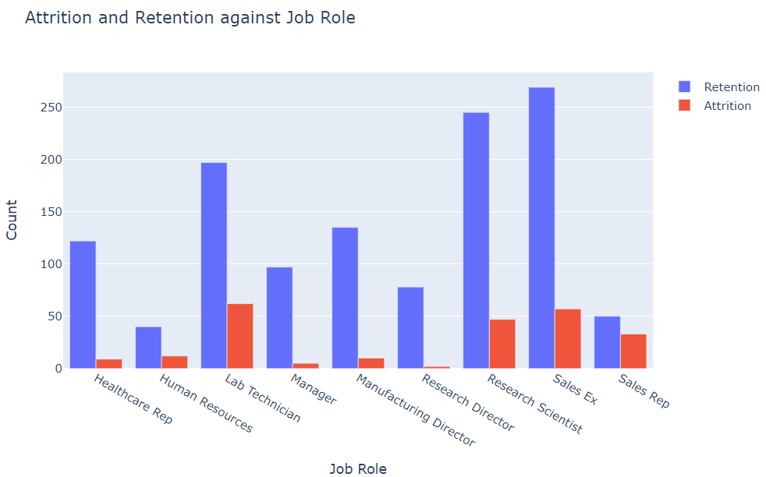
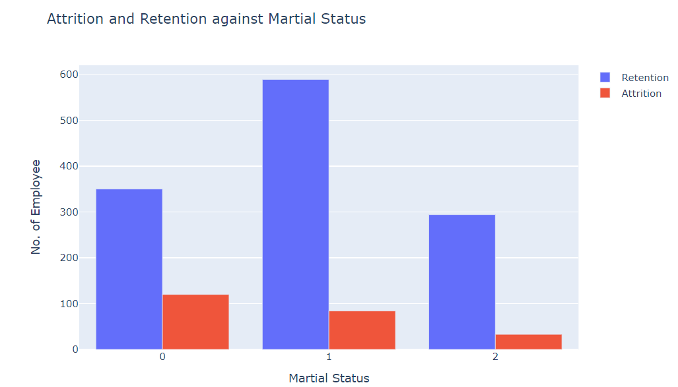
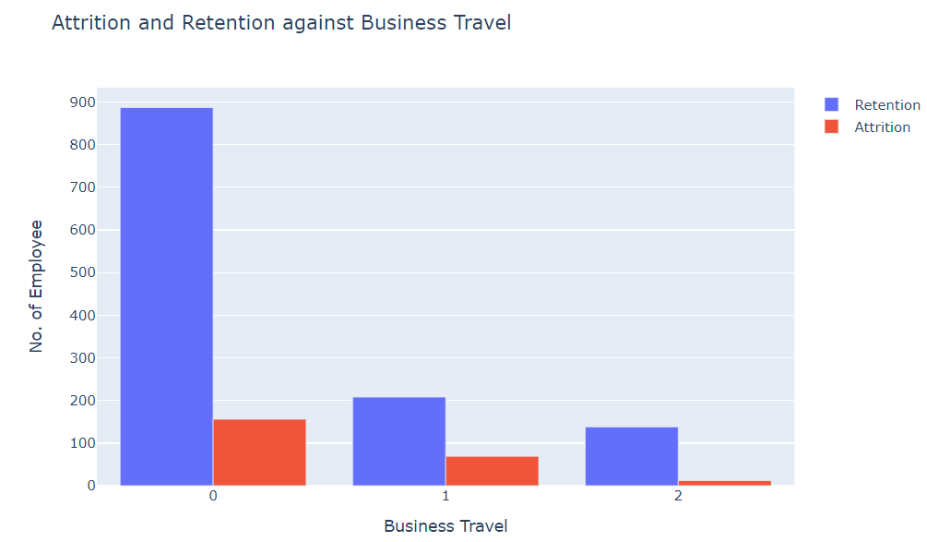
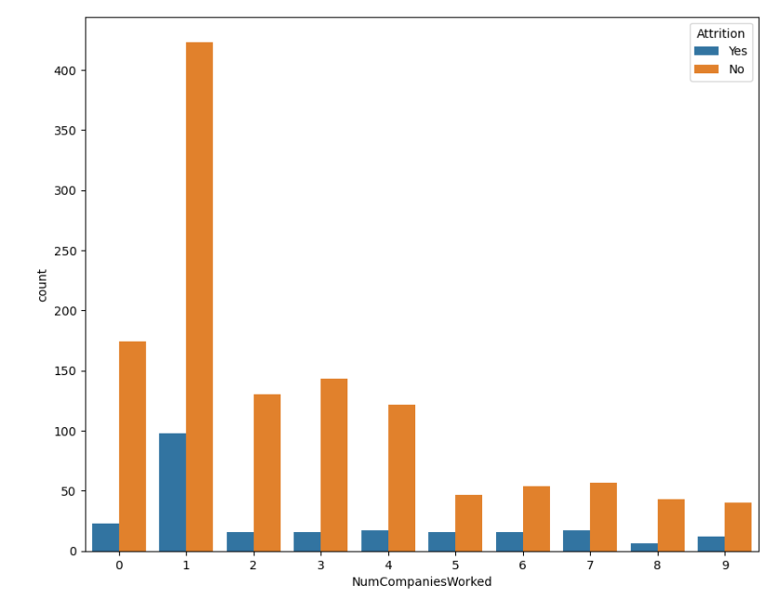

Slide 14
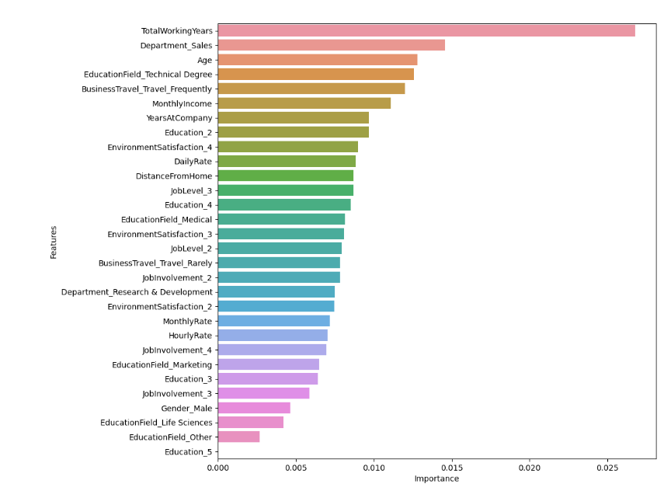
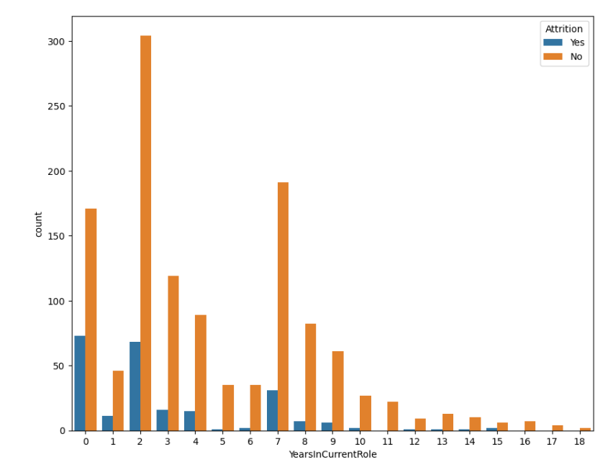

Slide 15
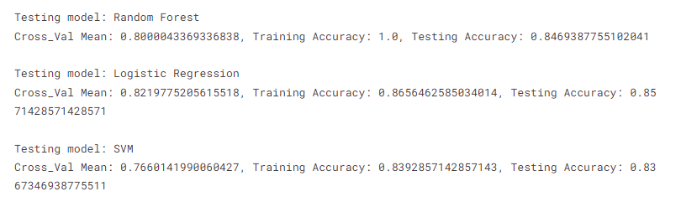
Model Building
Average cross-validation score for all three models are quite similar and relatively high.
But interestingly, we can see that a random forest model gives 100% accuracy while the other two are ~85% accurate for the training data. However, for the testing data, all the models give ~ 85% accuracy while the logistic Regression model predicts most accurately.

